Slide 1

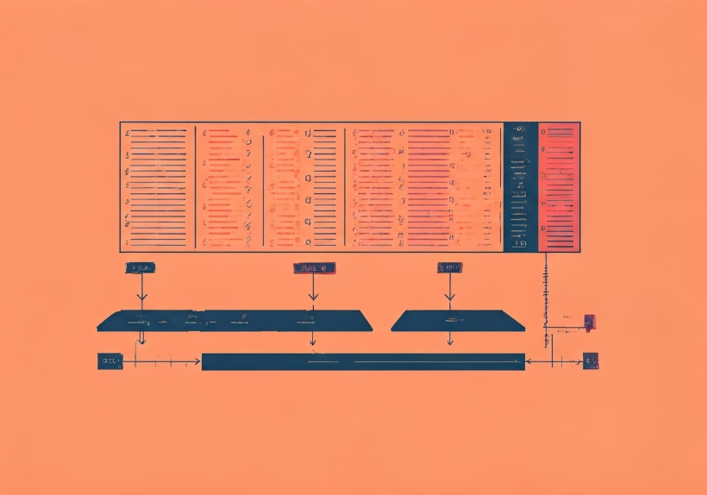
Efficient Memory Allocation with Gradient Checkpointing: Optimizing Neural Network Training
R. Babu Eshwar(192211778)
K. Venkata Ganesh(192211472)
N. Alexander Sai(192211514)
Guided by: Dr. Meganathan E

Slide 2

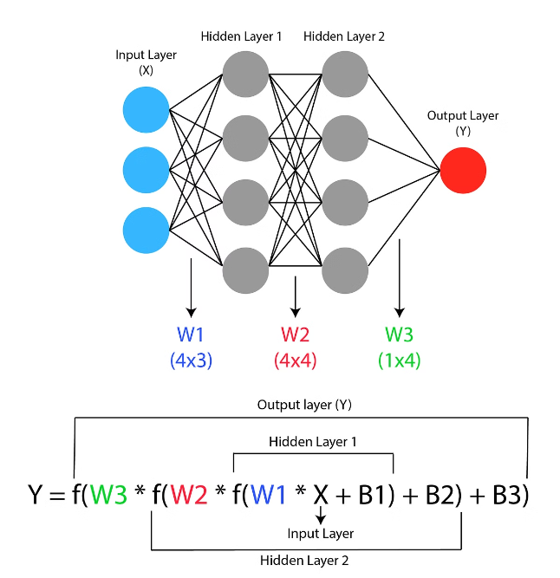
Introduction.
Gradient checkpointing is a powerful technique that can significantly reduce the memory footprint of training deep neural networks, enabling you to train larger and more complex models on limited hardware resources.

Slide 3
Challenges in Neural Network Training
Memory Limitations
Computational Complexity
Gradient Explosion/Vanishing
Training large neural networks requires a lot of memory to store activations and gradients during backpropagation, which can be a major bottleneck on GPUs with limited memory.
The computational cost of training deep neural networks can be very high, especially for large models and long sequences, slowing down the training process.
Gradient-based optimization algorithms can suffer from gradient explosion or vanishing, making it difficult to train deep neural networks effectively.

Slide 4

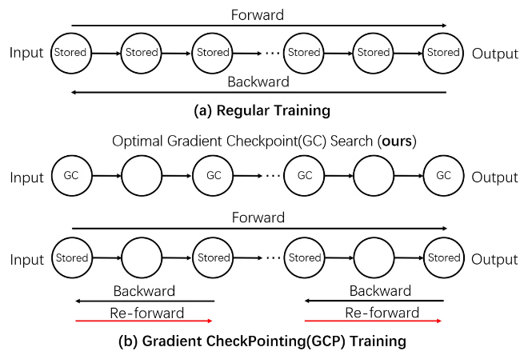
Gradient Checkpointing: An Overview
1
Reversible Computation
Gradient checkpointing leverages reversible computation to recompute activations during backpropagation instead of storing them, reducing memory usage.
2
Gradient Accumulation
The technique accumulates gradients across multiple steps, which can help mitigate the issues of gradient explosion and vanishing.
3
Memory-Computation Trade-off
Gradient checkpointing involves a trade-off between memory usage and computational cost, providing a flexible solution to optimize for different hardware constraints.

Slide 5

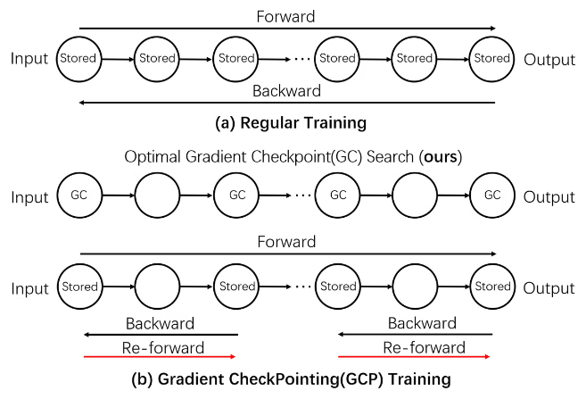
Principles of Gradient Checkpointing
1
Recompute Activations
2
Selective Checkpointing
Instead of storing all activations during the forward pass, gradient checkpointing recomputes them as needed during the backward pass.
The technique selectively checkpoints only a subset of the layers, balancing memory savings and computational overhead.
3
Reversible Layers
4
Gradient Accumulation
Gradient checkpointing works best with reversible neural network layers, which can be efficiently recomputed during backpropagation.
By accumulating gradients across multiple steps, gradient checkpointing can help mitigate the issues of gradient explosion and vanishing.

Slide 6

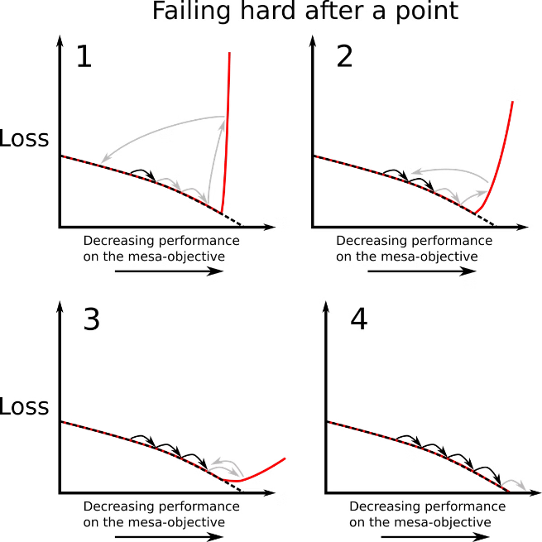
Implementing Gradient Checkpointing
Manual Checkpointing
Automatic Checkpointing
Manually implementing gradient checkpointing by modifying the neural network architecture and training code.
Using library-provided APIs or tools that automatically apply gradient checkpointing to your neural network model.
Optimizing Checkpointing
Integrating with Frameworks
Tuning the checkpointing strategy, such as selecting the optimal layers to checkpoint, to balance memory savings and computational overhead.
Seamlessly integrating gradient checkpointing with popular deep learning frameworks like TensorFlow, PyTorch, and Jax.

Slide 7





Advantages of Gradient Checkpointing
Memory Savings
Computational Efficiency
Significantly reduces the memory footprint of training deep neural networks, enabling you to train larger and more complex models.
Mitigates the computational overhead of recomputing activations, providing a favorable trade-off between memory and computation.
Improved Stability
Improved Scalability
The gradient accumulation feature of gradient checkpointing can help address the issues of gradient explosion and vanishing.
Enables training of larger and more complex neural network models, unlocking new possibilities in machine learning research and applications.

Slide 8


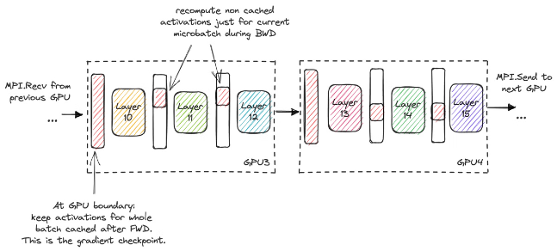
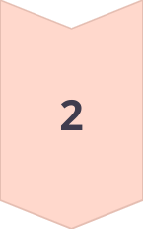
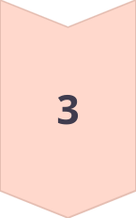
Tradeoffs and Considerations
Memory Savings
Significant reduction in memory usage, enabling training of larger models.
Computational Overhead
Increased computational cost due to the need to recompute activations during backpropagation.
Checkpoint Selection
Careful selection of the layers to checkpoint is essential to balance memory savings and computational cost.

Slide 9
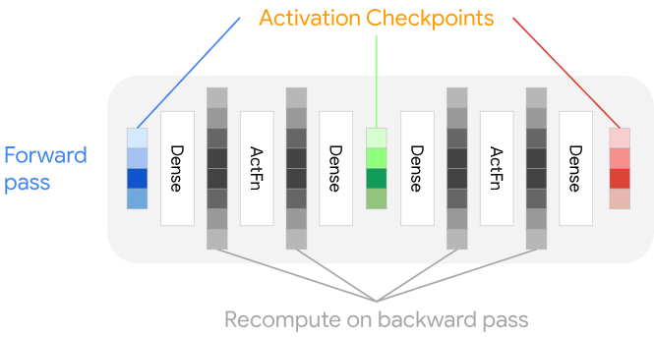
Practical Applications and Use Cases
Large Language Models
Training of massive transformer-based language models, such as GPT-3, that require huge amounts of memory.
Computer Vision
Enabling the training of deep convolutional neural networks for tasks like image classification, segmentation, and object detection.
Reinforcement Learning
Allowing the training of complex, memory-intensive reinforcement learning agents and environments.
Generative Models
Facilitating the training of large-scale generative models like variational autoencoders and generative adversarial networks.

Slide 10
Benchmarking and Performance Analysis
Memory Footprint Reduction
Computational Overhead
Training Convergence
The additional computational cost of recomputing activations during backpropagation is typically 10-30% compared to the baseline.
With careful tuning of the checkpointing strategy, gradient checkpointing can achieve similar training convergence rates as the baseline.
Empirical studies have shown gradient checkpointing can reduce the memory footprint of training deep neural networks by up to 80%.

Slide 11

Conclusion and Future Directions
1
Gradient Checkpointing Unlocks Potential
2
Continued Advancements
3
Wider Adoption and Integration
Researchers are exploring ways to further optimize the checkpointing strategy, integrate it with advanced training techniques, and apply it to emerging neural network architectures.
By addressing the memory constraints of training large neural networks, gradient checkpointing opens up new possibilities in machine learning research and applications.
As gradient checkpointing becomes more widely adopted, it will be seamlessly integrated into popular deep learning frameworks and toolchains, making it accessible to a broader audience.

